Slide 1
Data Structures (Lab-6)
Queues

Slide 2
Agenda for Today
What is Queue
Queue Operations
Circular Queue
Queue Implementation using Arrays
Task

Slide 3
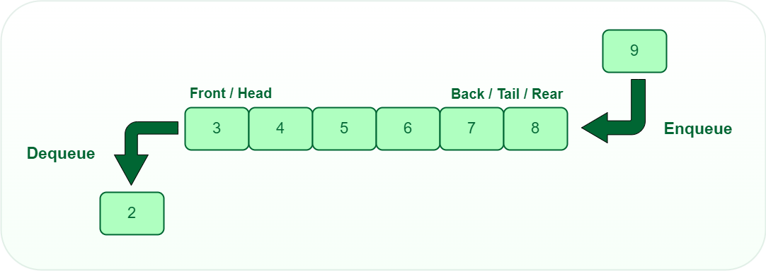
Queue
Visual Queue: https://www.cs.usfca.edu/~galles/visualization/QueueArray.html
FIFO
LILO

Slide 4
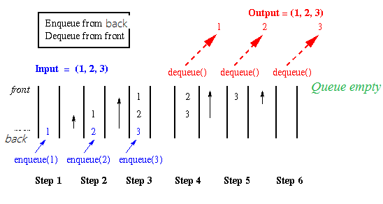
Queue in Action

Slide 5
Queue Operations
enqueue()
dequeue()
isEmpty()
isFull()
front()
rear()
queueSize()
display()
etc.

Slide 6
Queue Implementation Problem with Arrays
After a number of enqueue() & dequeue() operations, the rear/end/tail will always point to the end of the queue, indicating that the queue is full.
To solve this problem we will use the concept of Circular Queue
- Another problem is: fixed size of the queue.

Slide 7
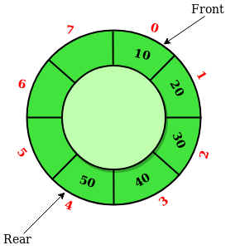
Circular Queue

Slide 8
Now, look at the Queue implementation using Arrays.

Slide 9
Task
You have to implement a method to check if the queue elements are sorted in ascending order or not, if yes return true, else return false
Method Signature
bool sortedAscQueue()
Test Case
Queue q = [2, 3, 8, 12, 18, 33]
Result => true

Slide 10
Thank you.

